Slide 1
E-COMMERCE WEBSITE (ONLINE SHOPPING)
PROJECT TITLE : SHOPZILLA
BATCH NO: 2
TEAM NO: 3

Slide 2
TEAM MEMBERS:
Abhijit Sarkar
Nishant Raj
Gayana K N
Rakesh C
Arjun Lal

Slide 3
CONTENTS :
INTRODUCTION TO PROJECT
PROBLEM STATEMENT
AIMS AND OBJECTIVES
SCOPE OF THE PROJECT
ADMINSTRATION MANAGEMENT LIST
. PAGES:
1.Home page
2.Login page
3.Product category page
4.Admin page
5.Seller page

Slide 4
CONTENTS :
MODULES:
1.Customer module
2.Admin module
3.Seller module
ARCHITECTURE DAIGRAM
USE-CASE DAIGRAM
FLOW DIAGRAM
SYSTEM SPECIFICATIONS
TESTING CHECKLIST
FUTURE PLAN
CONCLUSION

Slide 5
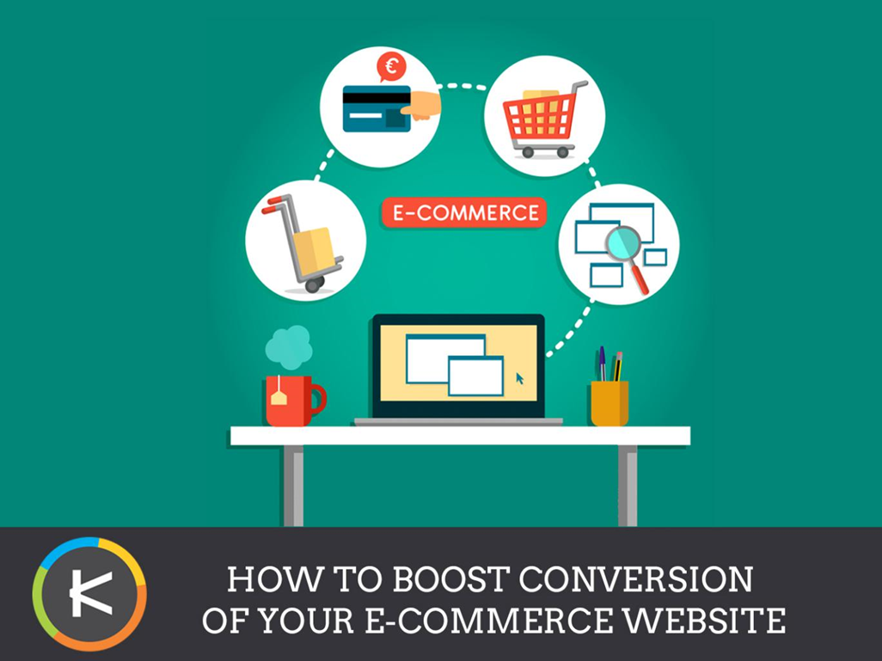
HOW TO BOOST CONVERSION OF E-COMMERCE WEBSITE:

Slide 6
WHAT IS E-COMMERCE?
Ecommerce is the buying and selling of goods and services over the Internet.
It is conducted over computers, tablets, smartphones, and other smart devices.
Almost anything can be purchased through ecommerce today.
It can be a substitute for brick-and-mortar stores, though some businesses choose to maintain both.
Ecommerce operates in four market segments, including business-to-business, business-to-consumer, consumer-to-consumer, and consumer-to-business

Slide 7
INTRODUCTION TO PROJECT:
An E-commerce website requires appropriate strategy of successful design and implementation. Everything is required to plan from scratch to end of website.
The e-commerce website will feature the online shopping facility of various fashion products under a single web space.
This website will allow multiple shopping vendors to sale their products online.
The product management in the system will be done in the form of categories

Slide 8
PROBLEM STATEMENT
Traditionally, customers are used to buying the products at the real, in other words, factual shops or supermarkets.
It needs the customers to show up in the shops in person, and walk around different shopping shelves.
With e-commerce , a company can sell products to a large customer base. However , there is a great deal of competition between individuals e-commerce sites.
A user expects to find what they need and want quickly and effortlessly when they visit an e-commerce site.
The purpose of any e-commerce website is to help customers narrow down their broad ideas and enable them to finalize the products they want to purchase.

Slide 9
AIMS AND OBJECTIVES:
The main objective is to develop an online fashion store providing customers with product information, reviews and comparison options.
To create an avenue where people can shop for fashion products online.
To develop a database to store information on fashion products and services.
Also manage shopping details, payments, customers.

Slide 10
SCOPE OF THE PROJECT
Every project is done to achieve a set of goals with some conditions keeping in mind that it should be easy to use, feasible and user friendly.
This project may help in effective and efficient order management.
In every shot time, the collection will be obvious, simple and sensible. It is very possible to observe the customer potentials and purchase patterns .
It is efficient managing all the operations of an online store within a single platform.
The project aims to automate the business process of the store. The proposed project would cover:
customer side , seller side , administration side , etc .

Slide 11
ADMINISTRATION MANAGEMENT UNIT LIST
The product management unit
Customer management unit
Admin login unit
Payment view unit
Admin logout unit

Slide 12
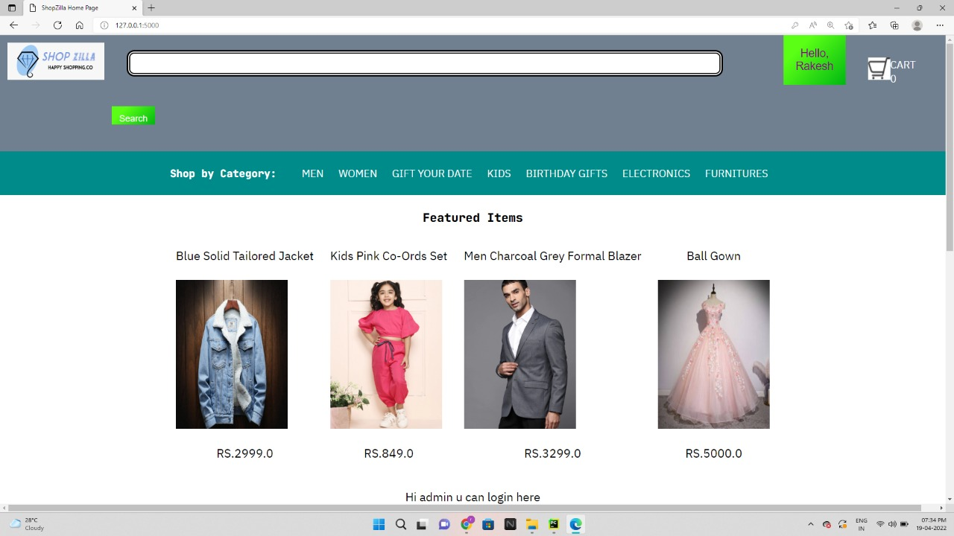
Home Page

Slide 13
REQUIREMENTS: Customer Module:
Customer can view products without login.
Customer can also add/remove product to cart.
When customer try to purchase product, then he/she must login to system.
After creating account and login to system, he/she can place order.
If customer click on pay button, then their payment will be successful and their order will be placed.
Customer can send feedback to admin.

Slide 14
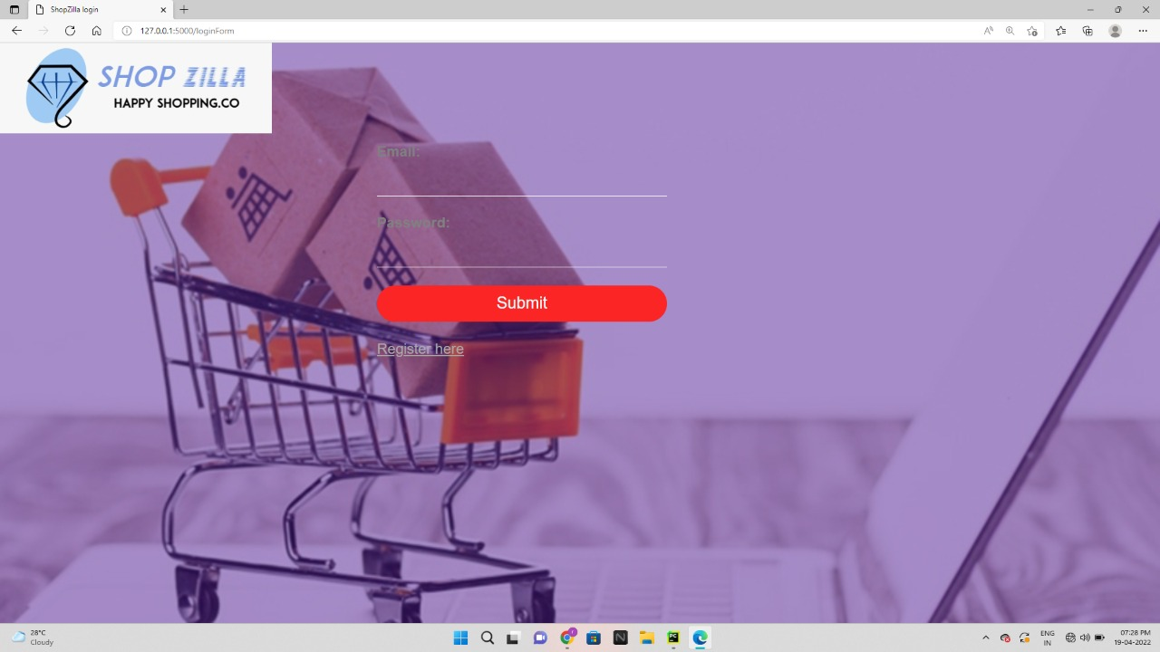
LOGIN PAGE

Slide 15
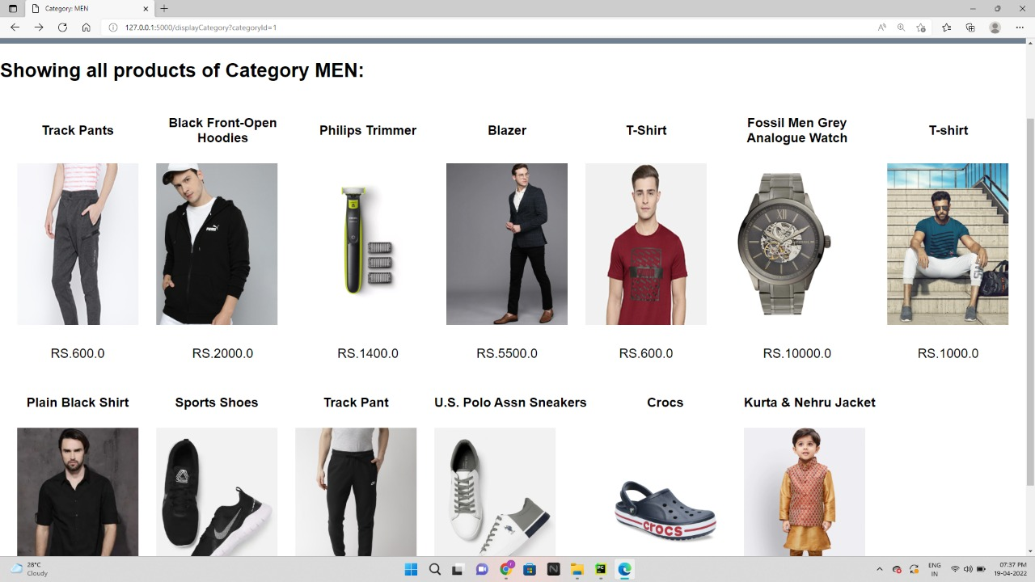
PRODUCT CATEGORY PAGE:

Slide 16
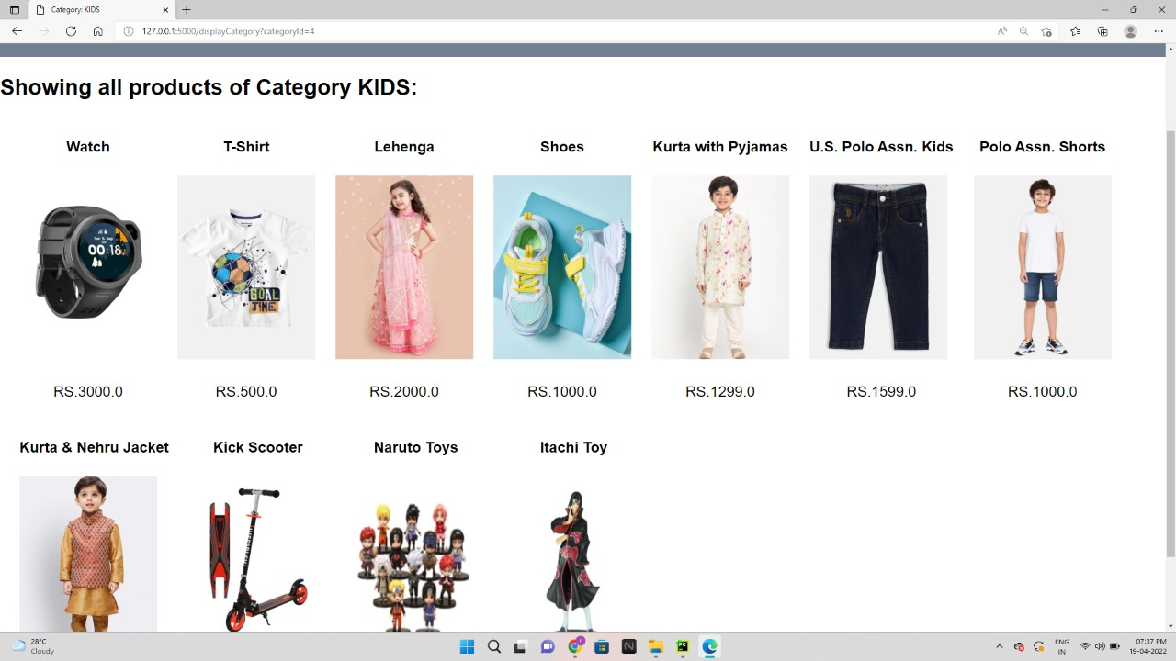

Slide 17
Admin Module:
Admin can provide username, password and your admin account will be created.
Admin can add/delete/view/edit the products.
Admin can view the feedbacks sent by customer.
Admin can add featured items.

Slide 18
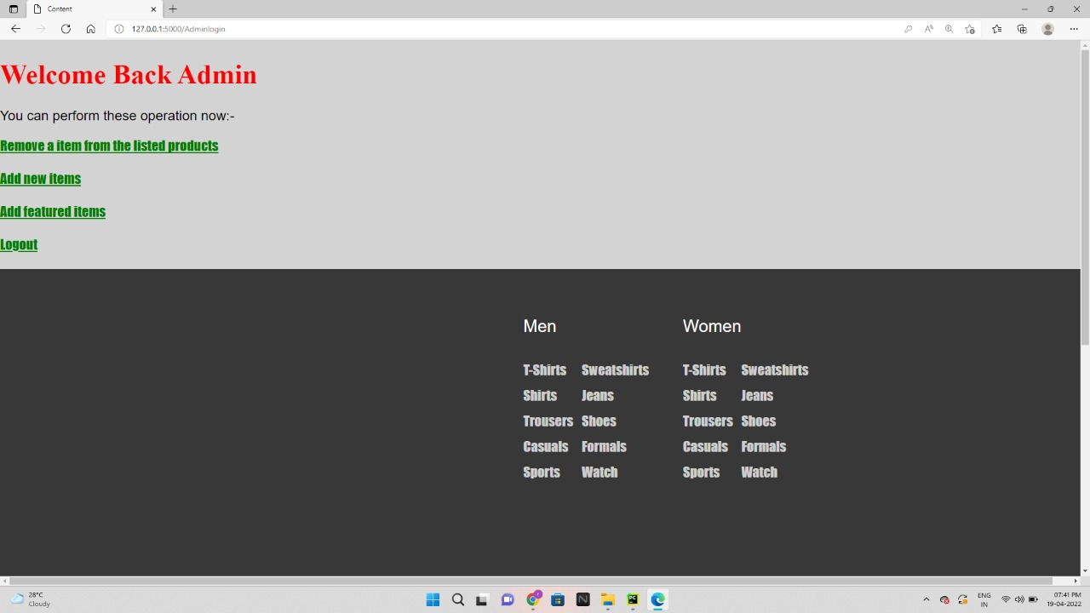
ADMIN PAGE:

Slide 19
Seller Module:
Seller can login through his/her details.
Seller can uploads image of the products.
Seller can include the price.
Seller can also show the stock of products.
After uploading the product details and his/her details seller can proceed to sell the product.

Slide 20
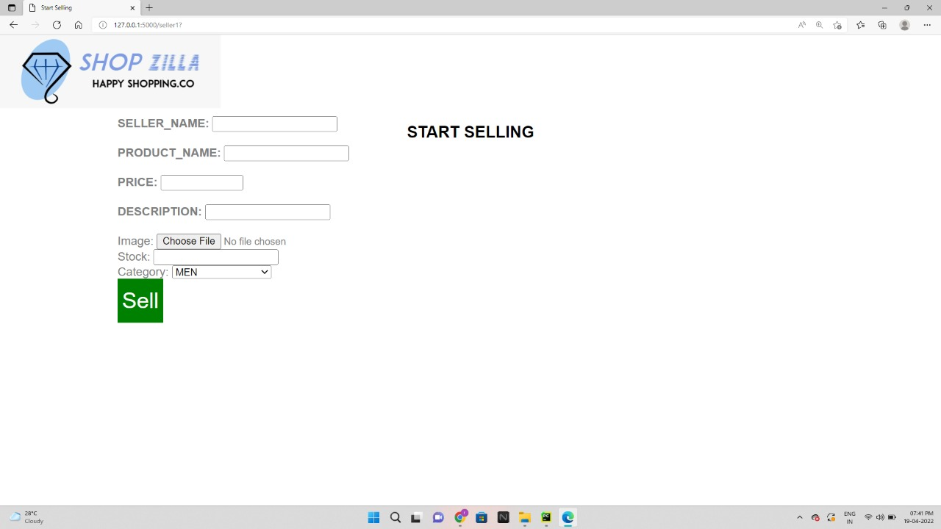
SELLER PAGE:

Slide 21
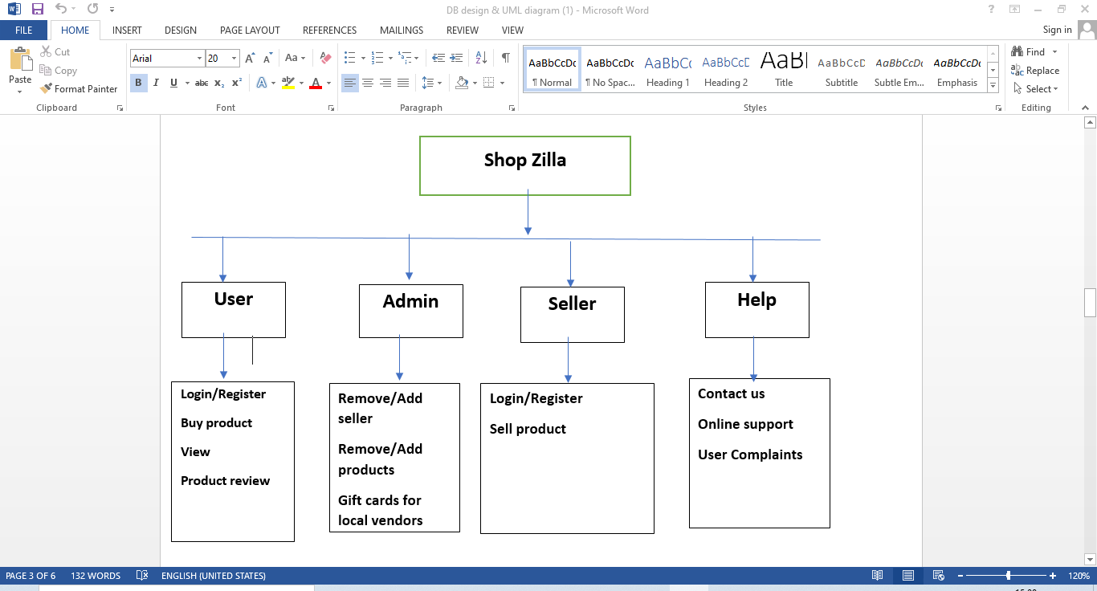
ARCHITECTURE DAIGRAM

Slide 22
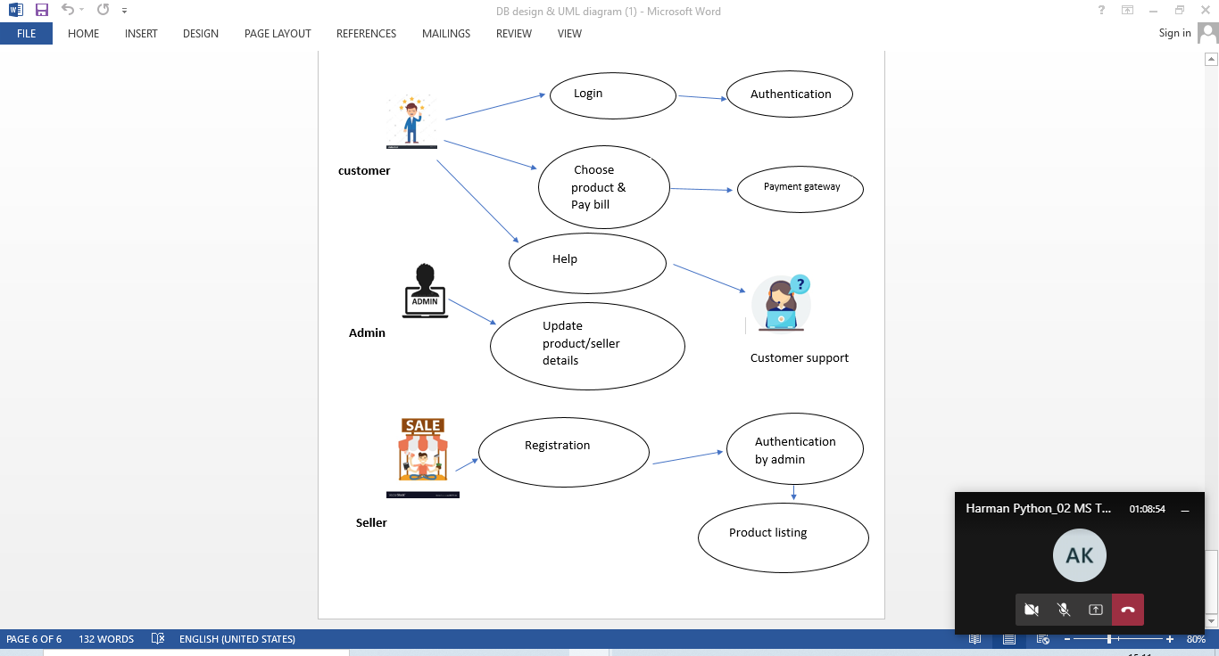
USE-CASE DAIGRAM

Slide 23
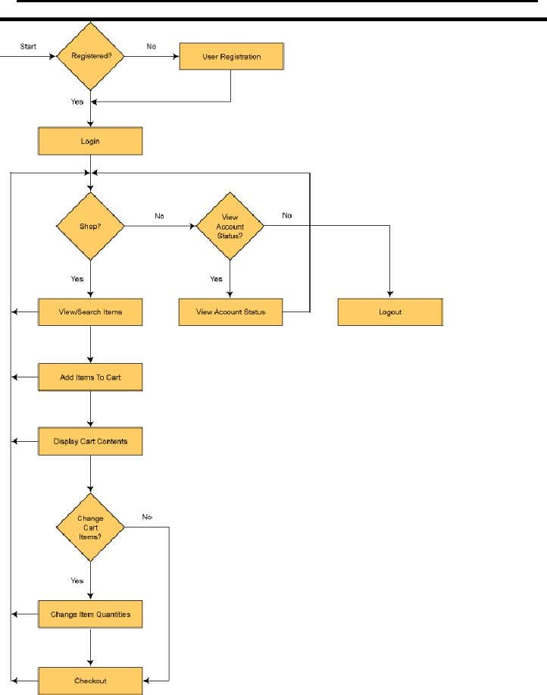
FLOW DAIGRAM:

Slide 24
SYSTEM SPECIFICATIONS
This section describes the hardware components and software requirements needed for effective and efficient running of the system.
HARDWARE REQUIREMENT:
Hardware Minimum System Requirements
Processor 2.4 GHz Processor speed
Memory 2 GB RAM

Slide 25
Software requirements
Software Minimum System Requirement
Operating System Windows 8, Windows 10 or MAC Ox ,LINUX
Database SQL Lite 3
Management System
Runtime Environment PyCharm or Visual Studio Code

Slide 26
TESTING CHECKLIST
Testing the home page of the e-commerce website
Testing user login and registration page
Testing the admin login page
Testing the category and product listing page of e-commerce website

Slide 27
TESTING CHECKLIST
Testing the product details
Testing the shopping cart of the website
Testing the checkout flow of an e-commerce site
Testing the logout flow of the website

Slide 28
FUTURE PLAN
We are thinking of some modifications and adding some advanced new features in system.
Some of them are:
(1). GUI modifications(more user friendly).
(2). Users can sell their products.
(3). Users can sign up/login using their social media accounts such as facebook , google , etc.

Slide 29
CONCLUSION
This project has been developed with much care and free of errors and at the same time it is efficient and less time consuming.
The purpose of this project was to develop a web application for purchasing items from a fashion shop.
This project enabled us gain valuable information and practical knowledge on designing web pages using html & CSS, usage of responsive templates and management of database using SQLite 3.
And also helped us learn how to test different features of the project.

Slide 30
THANK YOU!
ANY QUESTIONS?

